Slide 1
Sales Forecasting with Q360 v23.02
Presenters:
Roman Burchart and Brad Malone
May 29, 2024

Slide 2
Target Audience
Sales Representatives
Sales Management
Executive Management Team (optional)
  General
  Finance
  Operations

Slide 3
Learning Objectives
By the end of this session, you will be able to:
Define Sales Rep responsibilities including:
  Maintaining accurate Sales and Opportunity data in Q360
  Keeping a clean sales funnel and staying on top of daily / weekly / monthly activities
List forecast / tracking reports and dashboards that Sales Managers should regularly review with their Sales team
Communicate sales funnel info and forecasts to Executive Management
Share labor and project cost / revenue forecasting data with Operations

Slide 4





Agenda
Introduction
Context / Roles
Mock Sales Management Meeting – Immature
Key Attributes
Sales Cadence
Key Sales Reports
Mock Sales Management Meeting – Mature
Sales Management to Execs – Pipeline Update Ops / Finance
Q & A
Wrap Up & References
Sales Rep
Sales Manager

Slide 5









Introduction
What we see most often
or
Can we trust data/reports?
That was a surprise!!
"Write notes" or “Go sell?"
!!!
Sales Rep
Sales Leaders
Execs / Operations

Slide 6
2. Context: Purpose(s) of Sales Forecasting
Communicate Predictable Revenue
Communicate potential Labor requirements vs. capacity
Communicate potential cash expenditures
Support a shared plan to achieve desired Business Results
Who is involved?
Sales Reps
Sales Managers
Execs
Operations
Finance

Slide 7


2. Roles: Sales Representatives and Engineers
Sales Reps:
Capture opportunities which meet the Client’s requirements
Strive to meet Revenue and Gross Profit targets
Forecast for revenue / capacity planning
“Own” the Client relationship – establish the “price”
Sales Engineers:
Generate equipment list and labor estimates
Establish the cost basis for the project
Work with Operations to validate labor estimates
Notes:
Brad

Slide 8


2. Roles: Sales Managers
The conductors of a company’s revenue engine
Create and nurture high performance sales teams, and lead them to meet Customer needs and generate and hit revenue / gross profit forecasts
Three complementary roles:
  People manager
  Customer manager
  Business manager
Notes:
Brad

Slide 9


2. Roles: Execs and Finance
Executive Management:
Set Company Strategy (Portfolio) for Sales
  Target Markets / Customers / Solution sets
  Define growth and mix of business goals
  Specifically define what or who "not to sell"
  Meet revenue and profit goals (Gross and Net)
Financial Management:
Serve as Money Managers to ensure the smooth running of Operations / Service / Admin
  Making and presenting Financial and Progress Reports
  Perform cost analysis, conduct financial transactions, and evaluate budget / expenditures
Notes:
Brad

Slide 10
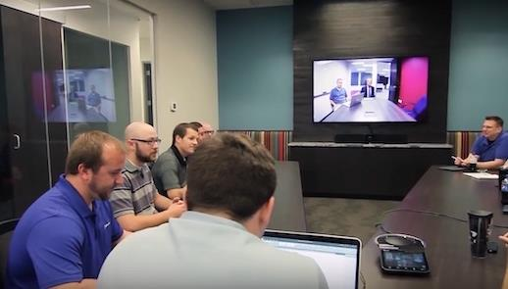
2. Roles: Operations
Provide resources and support for the projects (capacity)
Responsible for project deliverables / quality (capability)
May need to balance Project / Service demands
Owns the Implementation standards and flow through the organization
Owns the “cost” (and realized Gross Profit)
Notes:
Brad

Slide 11

3. Mock Sales Management Meeting – Immature
What’s Missing?
Confidence
Information
Purpose
Responsibility
Sales Rep
(Brad)
Sales Manager
(Roman)
Let's go to Q360...

Slide 12
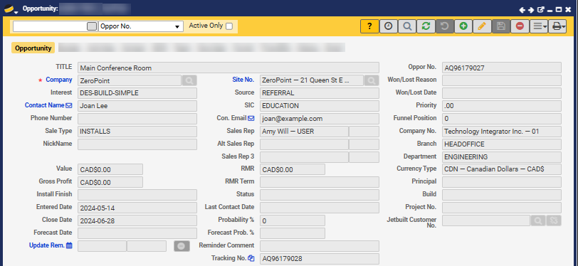
4. Sales Forecasting – Opportunity Form – Key Attributes
Interest – drives the selection of Sales Funnel
Contact Name and Email – of the Customer POC
Sale Type – drives GL filtering capability
Value – the anticipated Revenue of the Sale – continuously updated as Opportunity progresses
Gross Profit – the anticipated GP of the Sale – continuously updated as Opportunity progresses
Entered Date – the entry date of the Opportunity
Install Finish – the targeted system functionality date – “Live / Signed-off”
Close Date – the anticipated date the project is approved / awarded by Customer
Update Reminder – when to update information
# Regularly Updated

Slide 13
4. Sales Forecasting – Opportunity Form – Key Attributes
Source – Where the opportunity came from (filterable)
SIC – what general market (filterable)
Sales Rep – who the Primary Salesperson is (Commission)
RMR – the anticipated RMR revenue
Status – complements Funnel Stage
Probability – driven by Funnel Stage
Won / Lost Reason – trends / lessons learned (by Sale Type /SIC)
Won / Lost Date – filterable field
*Lag Time* – defaults to 30 days from Close (starts straight line revenue calculation based on equipment and labor forecasts)
# Regularly Updated

Slide 14
Poll #1
How disciplined are your Sales Reps (or those of the company down the street)? Select all that apply.
Very immature – they don’t typically fill out many fields
Immature – they try but need constant attention
Adolescent – they keep their information mostly accurate – but serving the Sales silo
Mature – their forecast information is accurate – knowing they serve the rest of the organization
Notes:
Anne Wong

Slide 15
5. Sales Cadence
What is a typical daily / weekly cadence for a Sales Rep?
Daily | Weekly
Review and modify reminders | Update Close and Install dates based on new information
Enter new opportunities | Update values based on new information
Complete reminder action items | Complete Activities – progress through Funnel
 | Prepare for and meet with Sales manager
 | Prepare for monthly Sales Overview mtg

Slide 16
6. Key Sales Reports
  Sales > Quick View
    Sales Forecast
      Longer weekly reviews
    View Funnel
      Company and Sales Rep levels
      Moving through the funnel, data should get better
    Sales Opp Review
      Historical review – look back
      Won / Lost filter
    Sales Bookings
  Dashboards > Sales > Sales Opportunities
    Review at least weekly
Let's go to Q360...

Slide 17
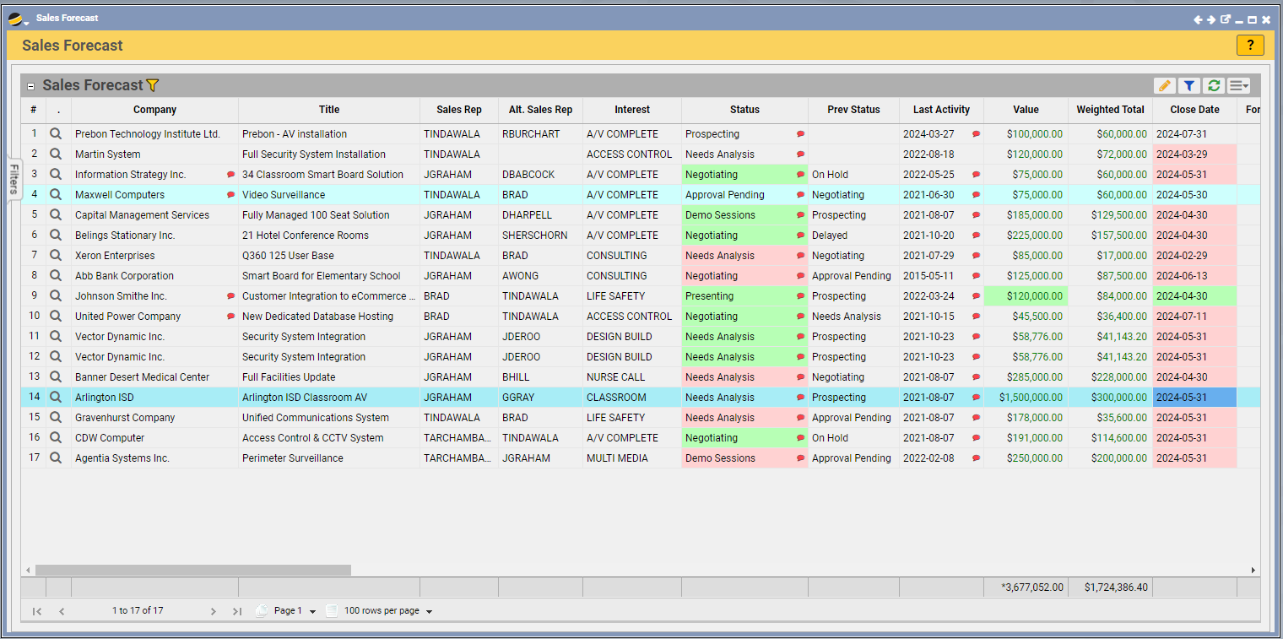
6. Sales Forecast

Slide 18
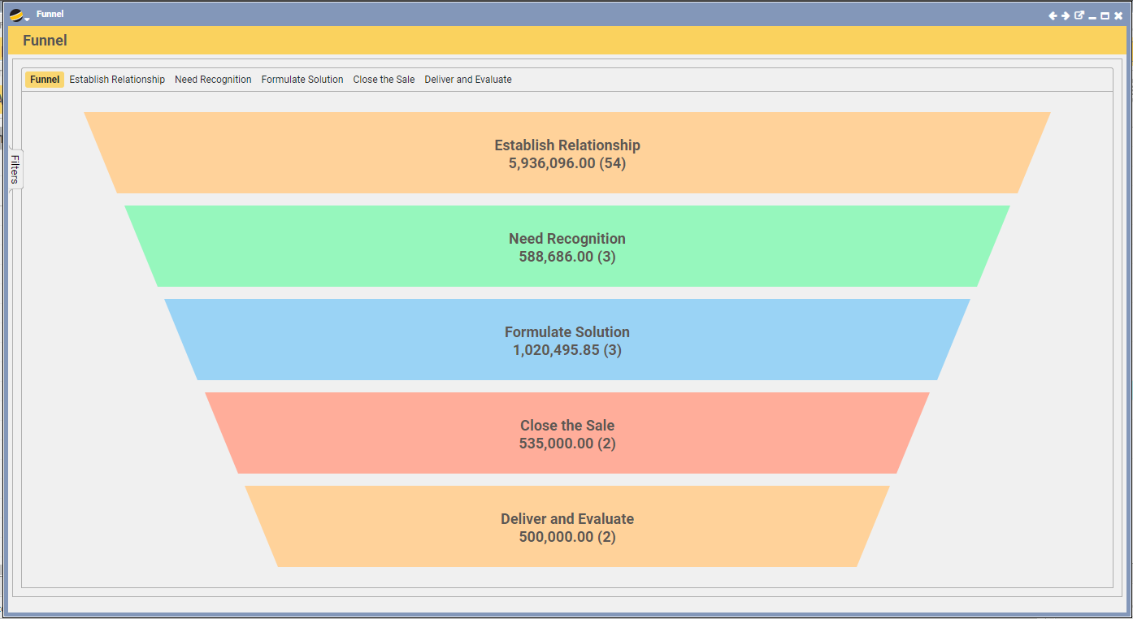
6. Quick Views > View Funnel

Slide 19
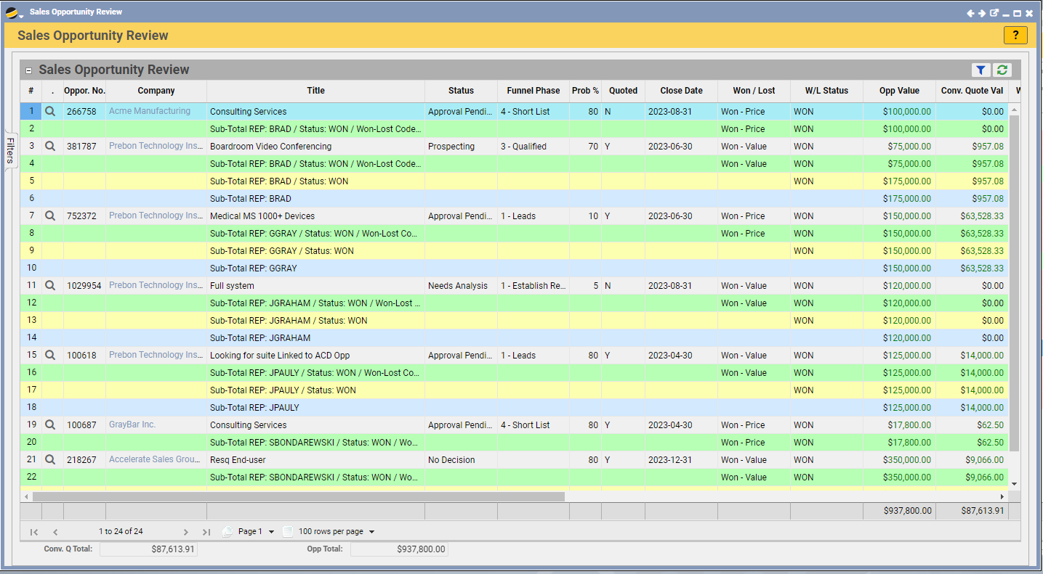
6. Sales Opp Review

Slide 20
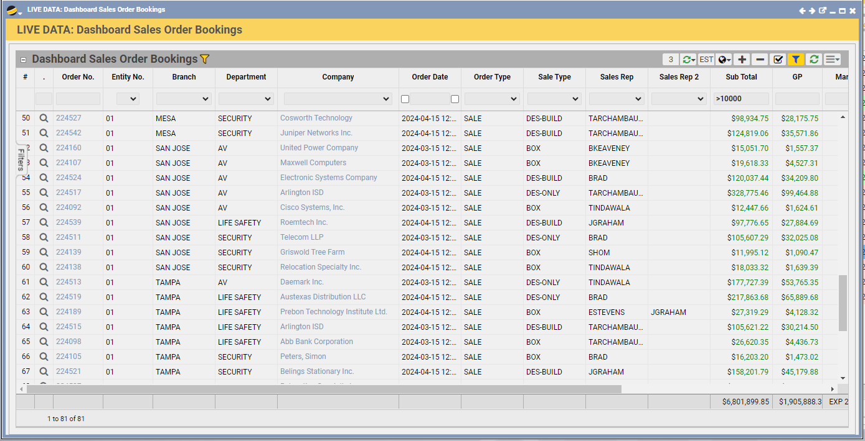
6. Sales Bookings

Slide 21
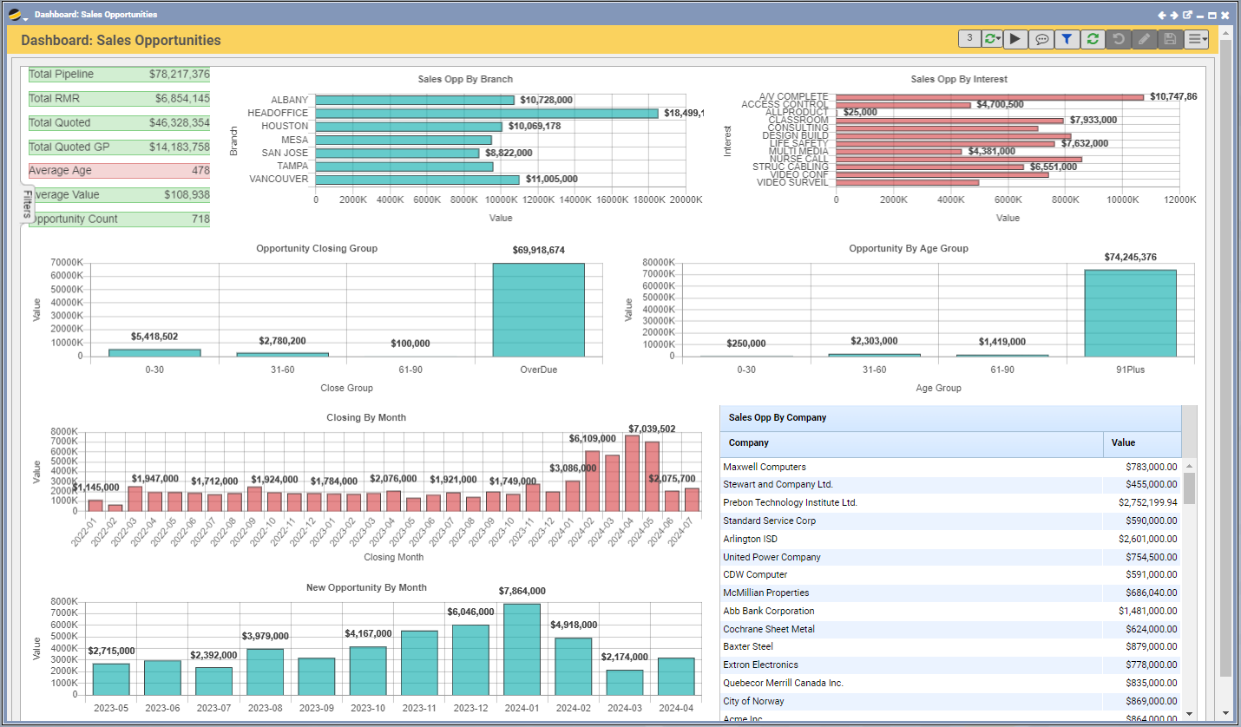
6. Sales Opportunities Dashboard

Slide 22
7. Mock Sales Management Meeting – Mature
Forecasting is a conversation in which you prepare to let leadership know how much and what your department will sell in a defined time frame (usually monthly or quarterly)
The Forecast is not just an Opportunity report. It is a commitment to your company to meet its projections
Review regularly one-on-one with each Salesperson
One specific day / time per week to have updated
Each pick at least one Opportunity to review in moderate depth
Sales Rep
(Brad)
Sales Manager
(Roman)
Let's go to Q360...

Slide 23
Poll #2
How well do Sales Managers review Sales Forecasts with their Sales Reps?
Cursory – not very disciplined
Needs work – we bluff our way through the meetings and promise to do better next time
Siloed – we look at forecasts from a summary revenue perspective – not labor or revenue / cost projections
Mature – we look at forecasting based on accuracy and projections – from a holistic perspective
Notes:
Anne Wong

Slide 24
8. Sales Management to Execs - Pipeline Update Ops / Finance
Cadence: Minimum monthly or on-demand as needed
Organizational lessons
  Win – Loss ratio by type and market (SIC)
Reports:
  Sales Forecast
  Sales Order Bookings Dashboard Report (Q0318)
  Sales Opportunities Dashboard (Org level)
  Labor Capacity Forecast including Opportunities
  One Dashboard including Opportunities

Slide 25
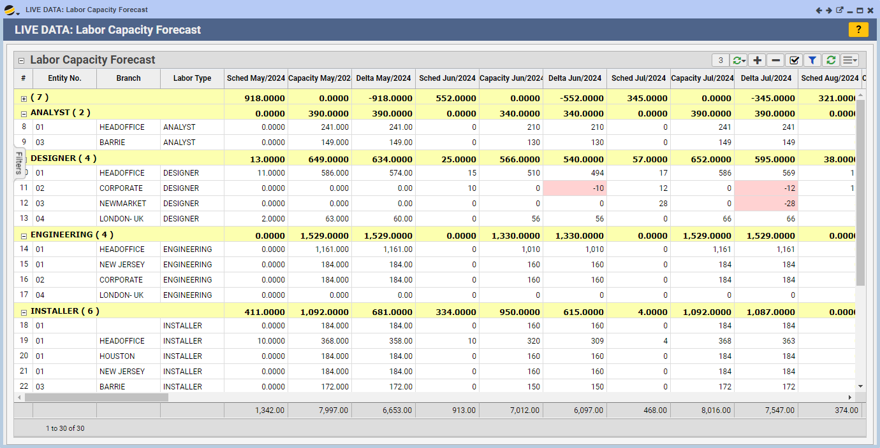
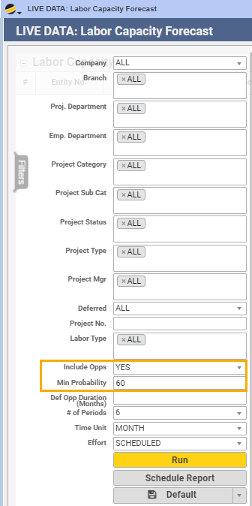


8. Labor Capacity Forecast including Opportunities

Slide 26
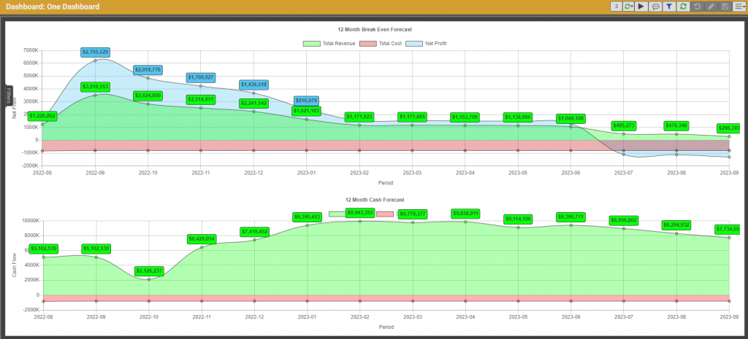
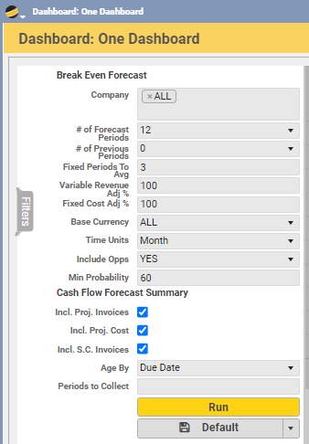
8. One Dashboard including Opportunities

Slide 27
Poll #3
How well do Sales Managers communicate future sales and their impact to General Management / Finance / Operations?
Not well at all – we rarely meet to review
We try to review forecasts, but the data is not often reliable
We regularly review forecasts, but not in a cross-functional way
We have regular reviews with accurate information and are able to make proactive decisions
Best Practice – minimum monthly unless significant news (positive / negative)
Notes:
Anne Wong

Slide 28

6. Q & A

Slide 29
Poll #4
Would you like to be contacted regarding further training on Sales Forecasting in Q360?
Yes
No
Would you like to be contacted regarding further training on Sales Reports in Q360?
Yes
No
Notes:
Anne Wong

Slide 30

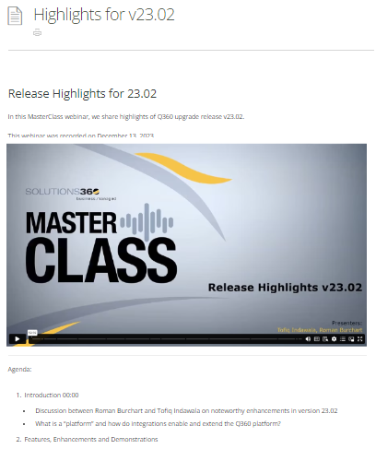
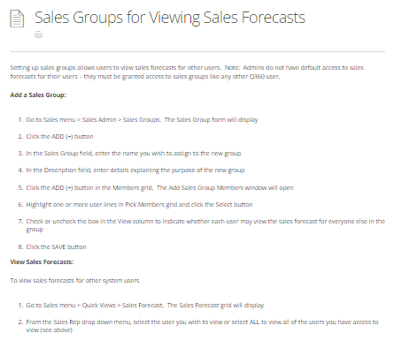
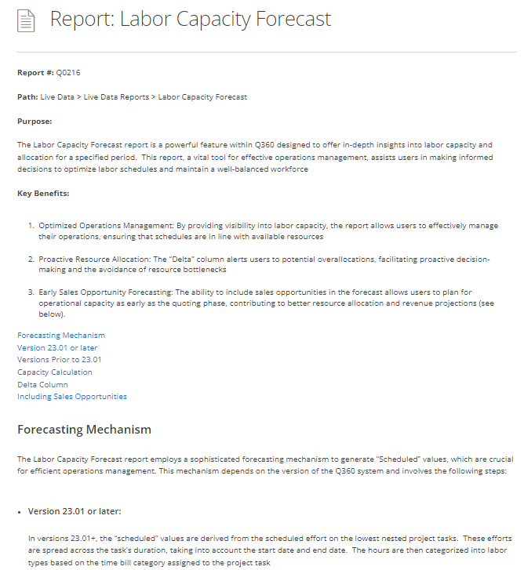
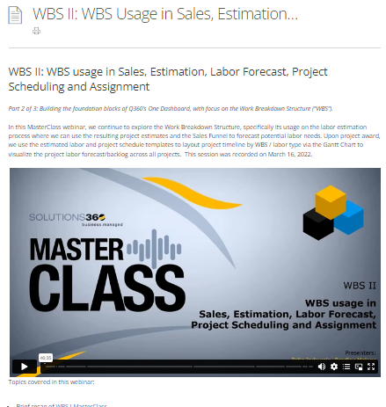
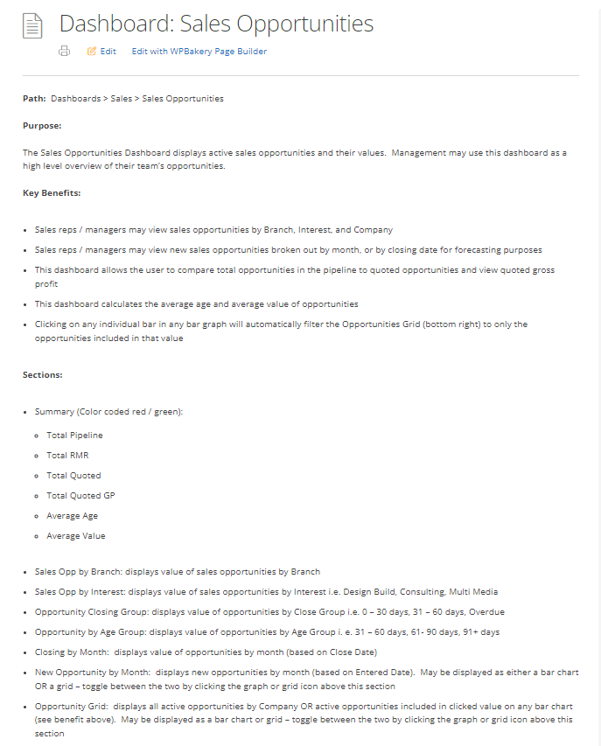
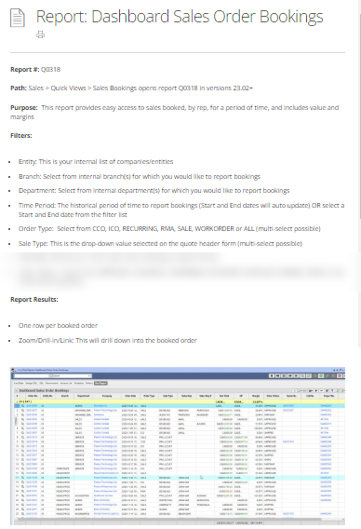
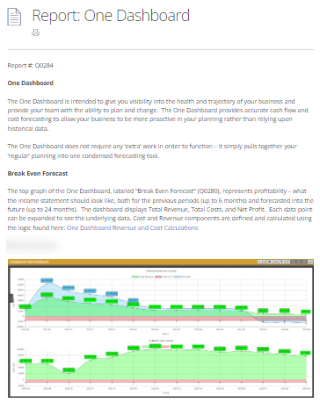
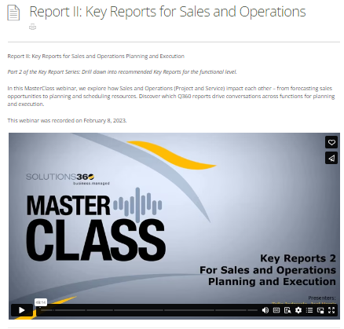
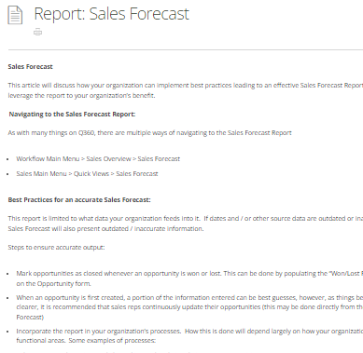
10. Wrap Up & References…
Tip: see
Help Center articles
Q360 > Help > Contents

Slide 31
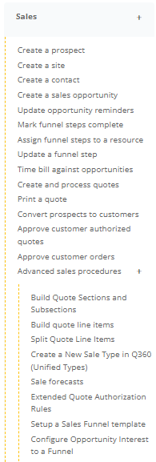
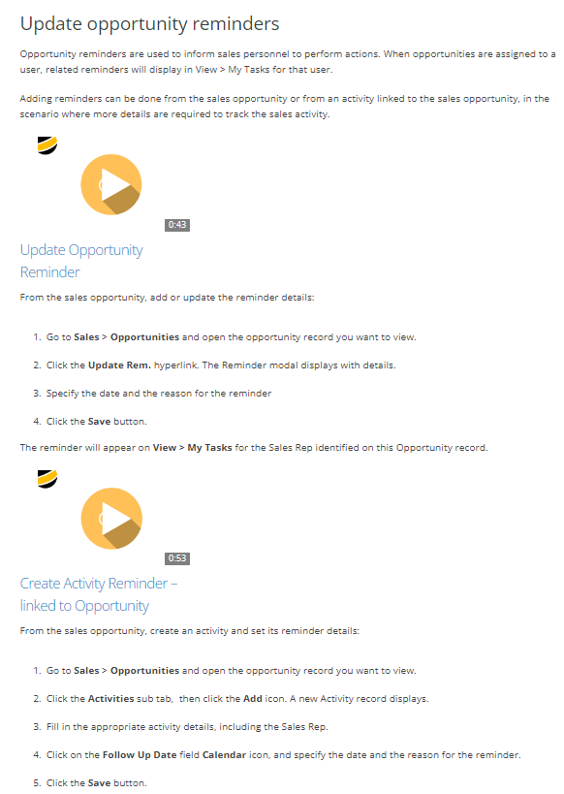
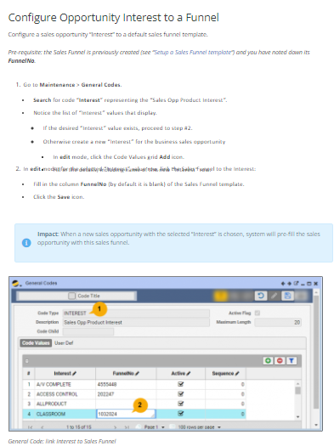
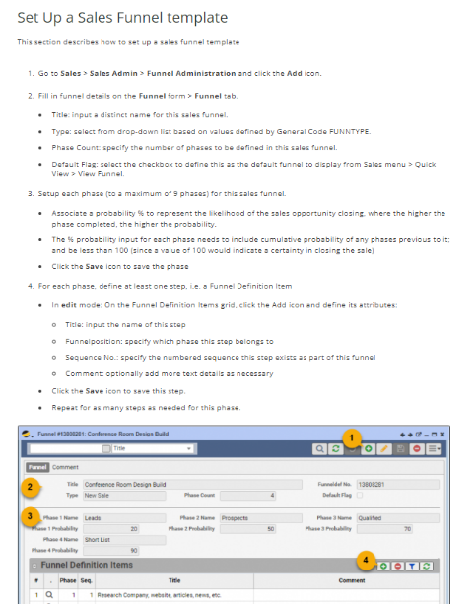
10. Wrap Up & References…
Tip: see
Help Center articles
Q360 > Help > Contents

Slide 32
10. Wrap Up & Reference
By the end of this session, you will be able to:
Define Sales Rep responsibilities including:
  Maintaining accurate Sales and Opportunity data in Q360
  Keeping a clean sales funnel and staying on top of daily / weekly / monthly activities
List forecast / tracking reports and dashboards that Sales Managers should regularly review with their Sales team
Communicate sales funnel info and forecasts to Executive Management
Share labor and project cost / revenue forecasting data with Operations

Slide 33
Thanks…
Sales Forecasting with Q360
v23.02
Presenters:
Roman Burchart and Brad Malone
May 29, 2024

